Slide 1

Exploring government contracting data to hold governments accountable in the Big Data Era
Mihály Fazekas
University of Cambridge, mf436@cam.ac.uk
Data for Policy conference, Cambridge, UK, 17/6/2015
Notes:
This is a workshop so stay tuned-in, discussion is open any time

Slide 2
The challenge of public procurement
9.3 trillion USD per year*
20-25% lost to corruption**
Should we be worried?
* http://www.open-contracting.org/data-standard-announcement
** OECD (2013), Implementing the OECD Principles for Integrity in Public Procurement. Progress since 2008. OECD, Paris
Notes:
Surveys, rough estimates

Slide 3
Overview
Big Data in government contracting?
State of data and data collection innovations
Indicators
3 examples
How you can get involved?

Slide 4
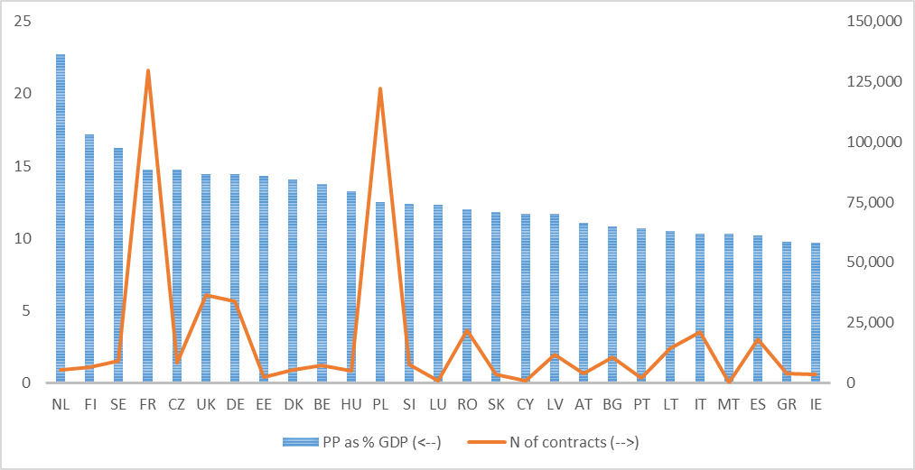
Why we need big data in PP?
2012, EU, TED

Slide 5
State of data I
DISASTER

Slide 6
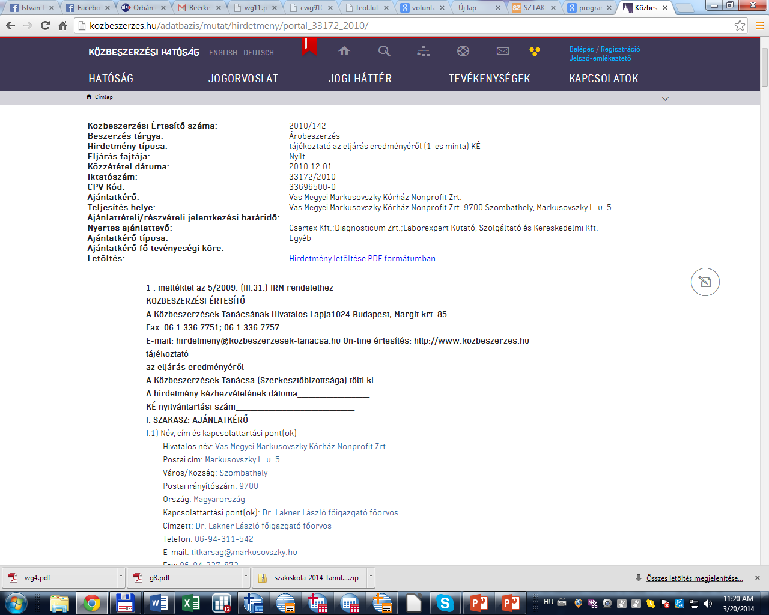
One example disaster ☺
Notes:
Structured text

Slide 7
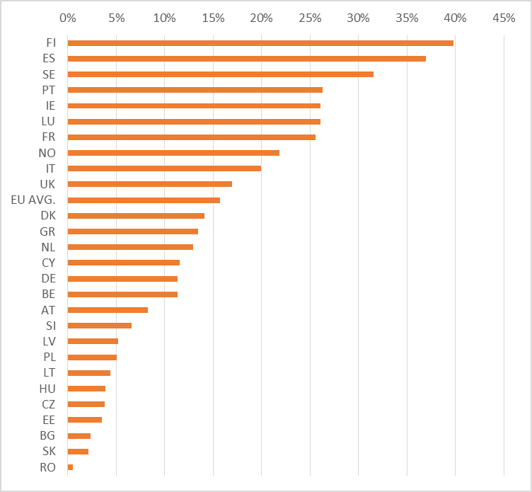
Average admin error
TED:2009-13
13 mandatory items:
Organisation name, address
Contract values
Subcontract
Dates
Notes:
procuring body address winner name winner address winner town winner post code winner country contract signature date nuts-3 code of contract performance including EU funds or not number of bids received type of assessment criteria used contract value using subcontracts or not

Slide 8
State of data II
Patchwork of data sources
  Formats: xml,html,pdf, etc
  Contents
  Quality
  Linking
Administrative data provision is not ready for Big Data
  Public initiatives: OCDS
  Civil society/reserach community: DIGIWHIST

Slide 9
DIGIWHIST
The Digital Whistleblower. Fiscal Transparency, Risk Assessment and Impact of Good Governance Policies Assessed
Goals
  Advancing anticorruption, transparency, and spending efficiency in public procurement
  Open data and indicators for 35 European countries: EU, EEA, Caucasus
  Enabling losers of corruption to mobilize
  Helping audit bodies fighting corruption, fraud, and collusion
Scope
  March 2015 – February 2018
  3 million eur (Horizon2020 funding)
  Consortium: Cambridge, Hertie, Open Knowledge Foundation DE, CRCB, Datlab, Transcrime
Notes:
Partnerships with authorities

Slide 10
DIGIWHIST: Data
Transparency and procurement legislation
Procurement data
Company information
Public organisation information
Asset declarations

Slide 11
DIGIWHIST: Indicators+utilization
Indicators:
  Corruption/favouritism
  Transparency
  Administrative quality
Utilization
  Web portals, mobile apps
  Whistleblower reporting: Big Data+user info
  Risk assessment software for public servants

Slide 12
Indicator building
New approach to corruption in PP
  harnessing BIG DATA,
  built on thorough understanding of context, and
  ‚open-ended’
Indicator characteristics:
  Specific
  Real-time
  ‘Objective’/hard
  Micro-level
  Aggregatable + comparative
Notes:
Objective in a sense that it is ‚hard’ data and lot of people checked them, they are manupilated, but that can be measured

Slide 13
Notes:
Public procurement simplified example

Slide 14
3 hands-on examples
For
  The activist
  The policy maker
  The economist

Slide 15
Big Data for accountability
www.tendertracking.eu
Goal: Holding governments accounatble
All regulated contract since 2005 in Hungary
Structured micro data+aggregates
Indicators making sense of Big Data
Target groups:
    Citizens, journalists
    Policy makers
    Researchers

Slide 16
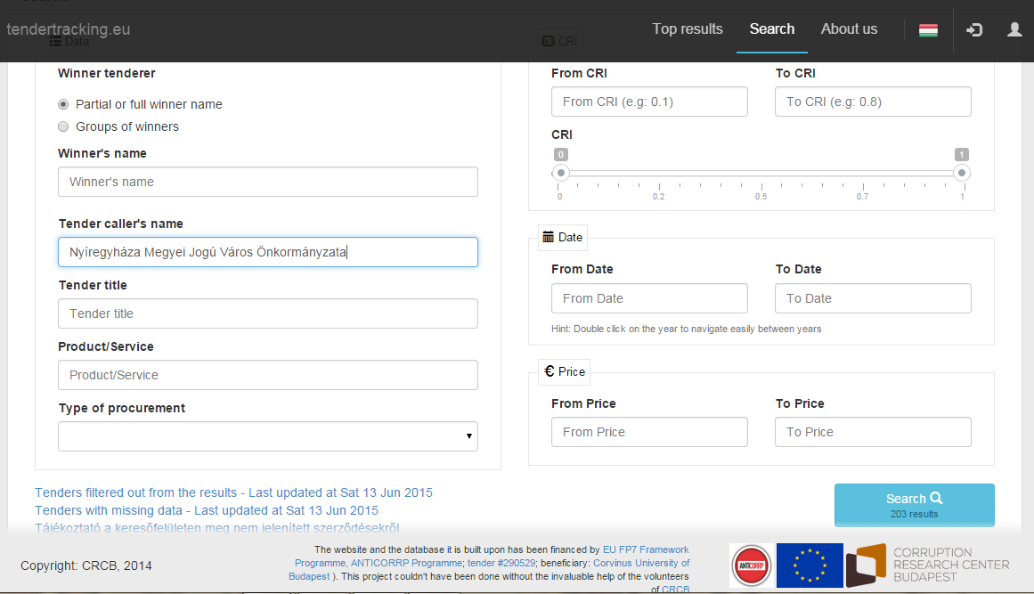
Notes:
Standard search with some add-ons: CRI

Slide 17
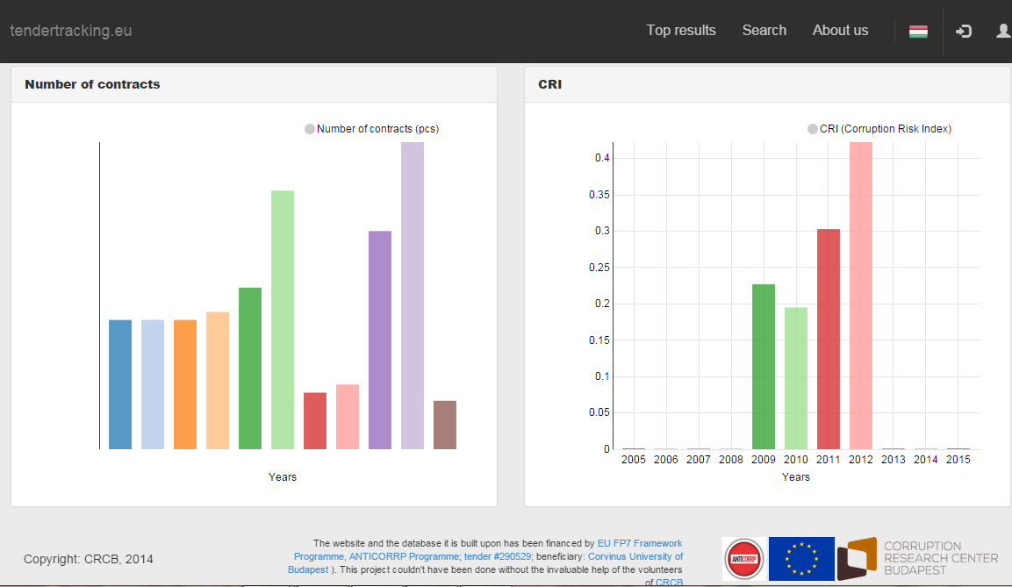
Notes:
Descriptive stats I

Slide 18
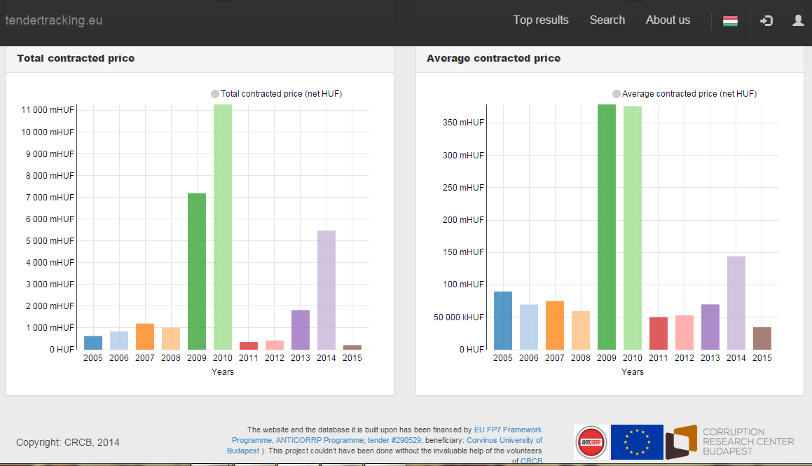
Notes:
Descriptive stats II

Slide 19
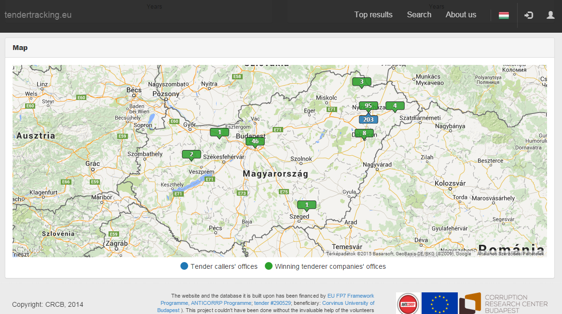
Notes:
Localize procurement!

Slide 20
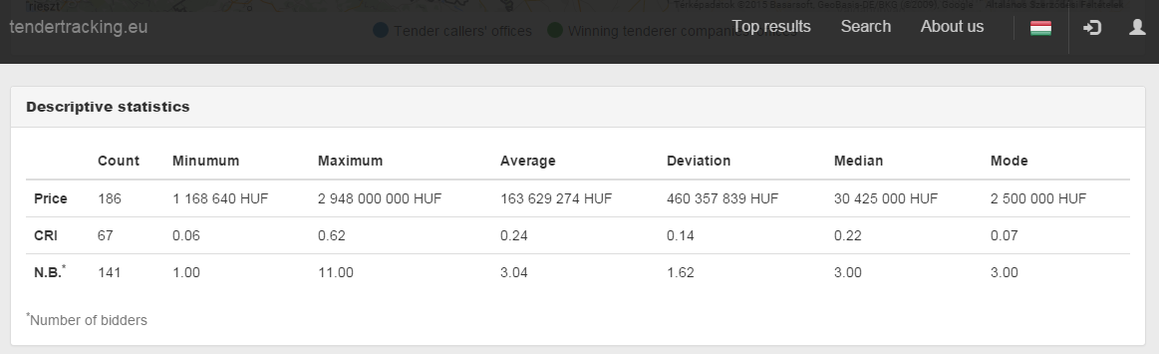
Notes:
Track corruption risks

Slide 21
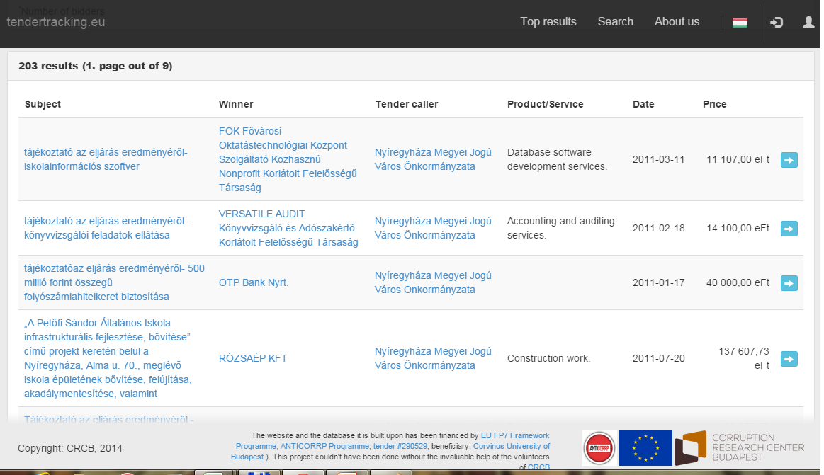

Slide 22
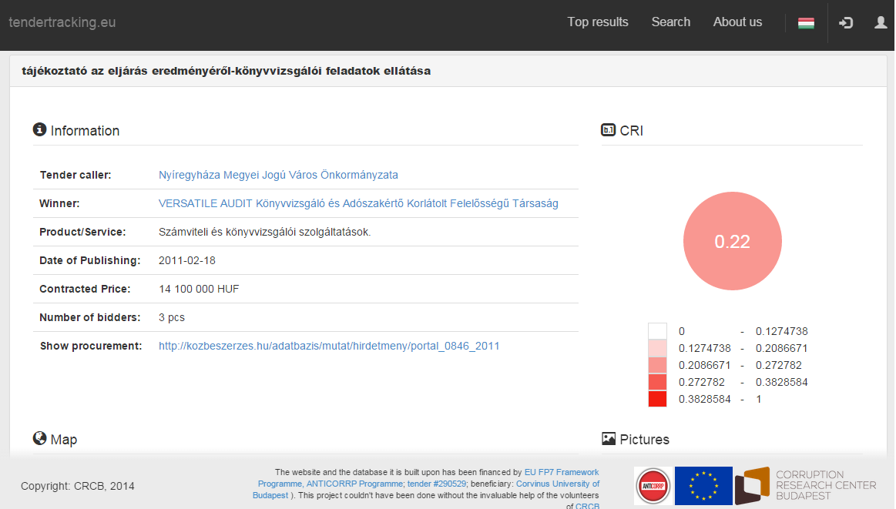

Slide 23
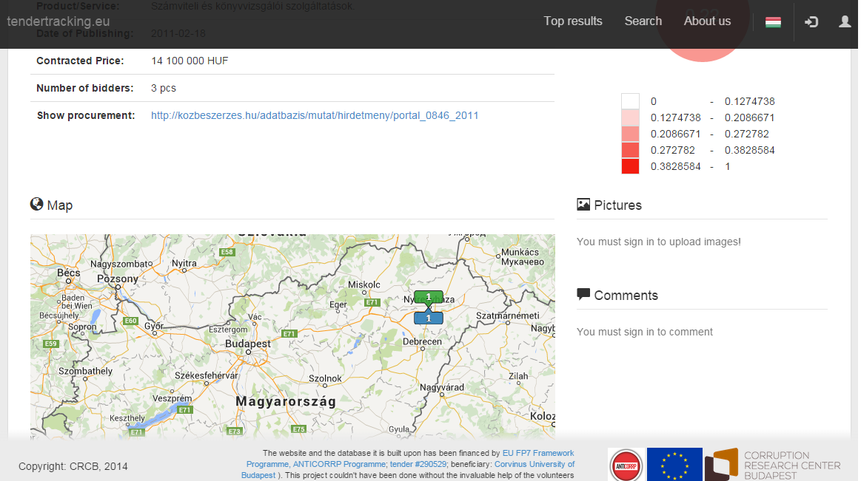

Slide 24
Discussion points
Which features would you like to see on such a portal?

Slide 25
Big Data for austerity
http://www.crcb.eu/?p=867
Goal: identifying companies with preferential treatment
Data: public procurement+company data: UK
Target group
  Policy makers (those not benefitting of course☺)
  Losing bidders
  Journalists

Slide 26
Political Influence Indicator (PII)
political influence on companies’ market success
Change of government as a natural experiment
  Company performance before-after gov’t change
  Evidence of favouritism: tendering red flags

Slide 27
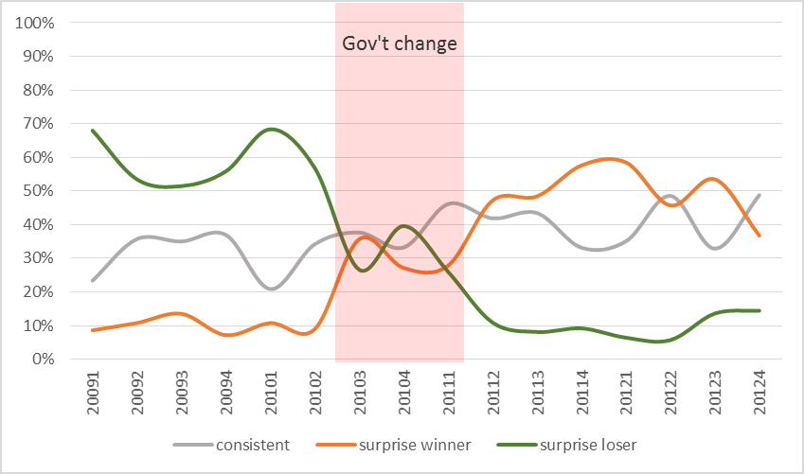
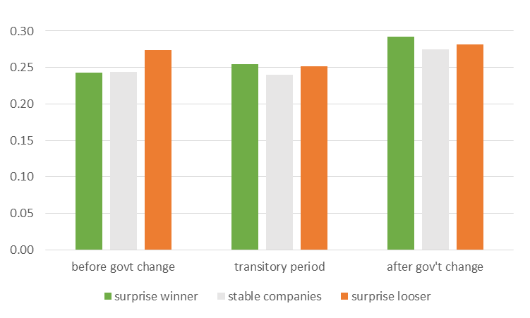
Paradigmatic case: Hungary
Government change + CRI
2009-2012

Slide 28
How does the UK score?
Central government only
2009-2010-2013
Company panel data
TED data
  large contracts
  Imperfect company identification
Download link: http://www.crcb.eu/?p=867
Let’s explore the data together!

Slide 29
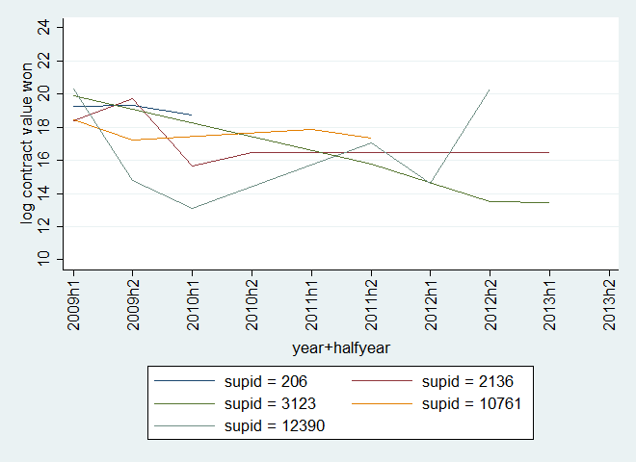
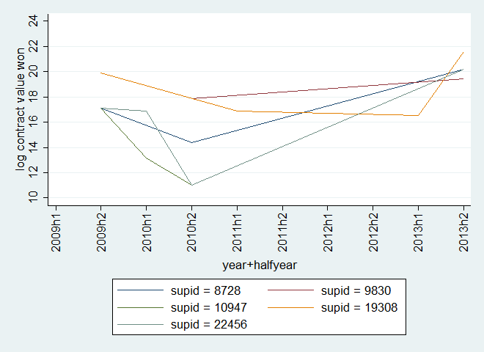
SOME suspicion
◄ 2009h1 largest 5
▼2013h2 largest 5
xtline sum_ls_org if best==1, ylabel(10(2)24) xlabel(#10, angle(vertical)) ytitle("log contract value won") overlay
xtline sum_ls_org if best==2, ylabel(10(2)24) xlabel(#10, angle(vertical)) ytitle("log contract value won") overlay

Slide 30
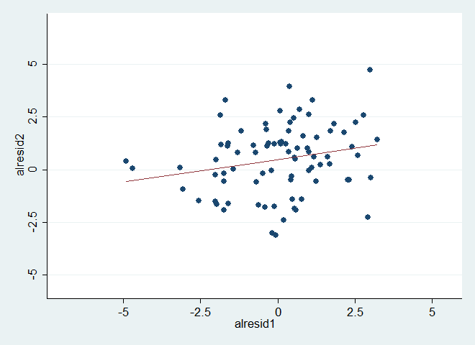
Suspicious error term patterns
Systematic deviations from the regression line
twoway (scatter alresid2 alresid1)(lfit alresid2 alresid1), xlabel(-5(2.5)5) ylabel(-5(2.5)5) legend(off) ytitle("alresid2")

Slide 31
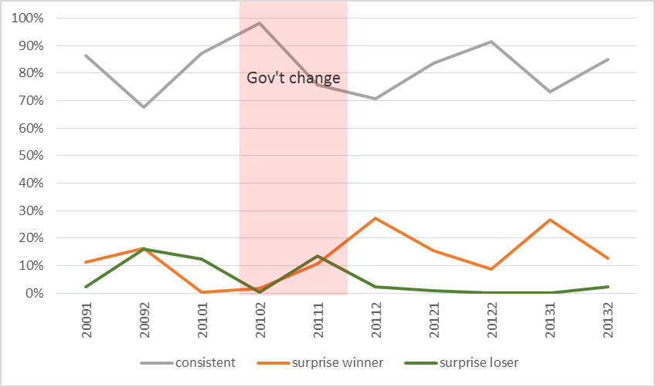
UK central admin: PII

Slide 32
Discussion points
Any comments on the methodology?
How to use the results if nothing is apparently illegal?
Someone wants to write an article about these companies☺?

Slide 33
Big Data for competition
Bidder data, Hungary, 2007&2009
Goal: identifying suspicious bidding patterns
Target group:
  Competition authorities
  Losing bidders

Slide 34
Network data set-up
Co-bidding network
  Construction work for pipelines, communication and power lines, for highways, roads, airfields and railways
  3 regional and 1 national markets in 2007&2009
Nods: bidding firms (winners and losers)
  size=number of tenders won
  colour=network position (green=cut-point)
Edges: bidding on the same tender
  width=number of times companies co-bid

Slide 35
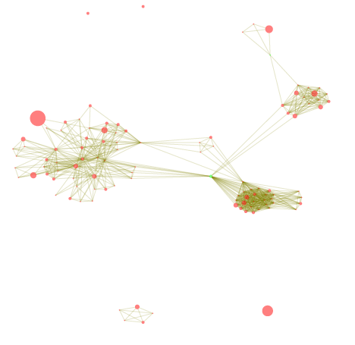
Co-bidding patterns: benchmark
2007
Dense networks
Few cutpoints
Cutpoints don’t benefit from position
Notes:
Vertex=bidding company (size=number of tenders won)
Edge=cobidding (width=number of tenders)
Colour=position (green=cut-point)
Hihglight how a healthy market looks like: bottom right dense network

Slide 36
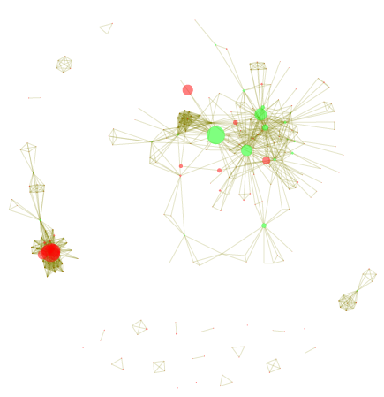
Co-bidding patterns: suspicion
2009
Dense networks
Many cutpoints
Cutpoints seem to benefit from position
Notes:
Higher prices
More subcontracting

Slide 37
Discussion points
Any comments on the methodology?
How to mainstream such Big Data analysis in government work?
How to bring suspicious cases to court?

Slide 38
Getting involved
Email me: mf436@cam.ac.uk
Visit: digiwhist.eu
As a User
  Hunt for suspicious transactions
  Download the data for analysis
As a Contributor
  Let us know what you need
  Tell us about your story
  Link your data

Slide 39
Background material
SOON COMING UP: digiwhist.eu
Fazekas, M. and Tóth, I. J. (2014). From corruption to state capture: A new analytical framework with empirical applications from Hungary. CRC-WP/2014:01, Budapest: Corruption Research Centre.
Czibik, Ágnes; Fazekas, Mihály; Tóth, Bence; and Tóth, István János (2014), Toolkit for detecting collusive bidding in public procurement. With examples from Hungary. Corruption Research Center Budapest, CRCB-WP/2014:02.
Fazekas, M., Chvalkovská, J., Skuhrovec, J., Tóth, I. J., & King, L. P. (2014). Are EU funds a corruption risk? The impact of EU funds on grand corruption in Central and Eastern Europe. In A. Mungiu-Pippidi (Ed.), The Anticorruption Frontline. The ANTICORRP Project, vol. 2. (pp. 68–89). Berlin: Barbara Budrich Publishers.
Fazekas, M., Tóth, I. J. (2014), Three indicators of institutionalised grand corruption using administrative data. U4 Anti-Corruption Resource Centre, Bergen, U4 Brief 2014:9.
Fazekas, M., Tóth, I. J., & King, L. P. (2013). Anatomy of grand corruption: A composite corruption risk index based on objective data. CRC-WP/2013:02, Budapest: Corruption Research Centre.
Fazekas, M., Tóth, I. J., & King, L. P. (2013). Corruption manual for beginners: Inventory of elementary “corruption techniques” in public procurement using the case of Hungary. CRC-WP/2013:01,Corruption Research Centre, Budapest.
Fazekas, M., Tóth, I. J., & King, L. P. (2013). Hidden Depths. The Case of Hungary. In A. Mungiu-Pippidi (Ed.), Controlling Corruption in Europe vol. 1 (pp. 74–82). Berlin: Barbara Budrich Publishers.

Slide 40
Thanks a lot!

